Slide 1


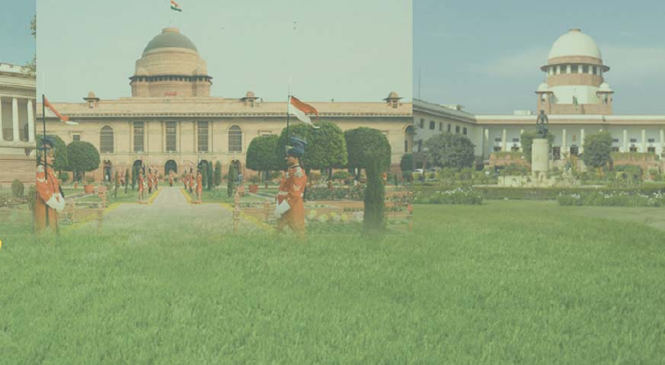

Slide 2
VIDEO

Slide 3
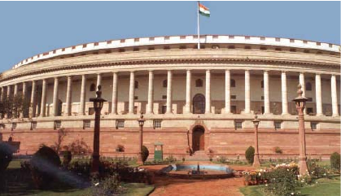
PARLIAMENT BUILDING

Slide 4
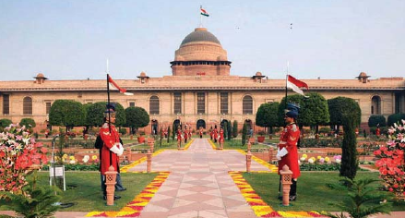
THE OFFICIAL RESIDENCE OF THE RESIDENCE OF INDIA

Slide 5
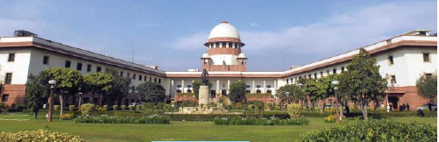
SUPREME COURT

Slide 6
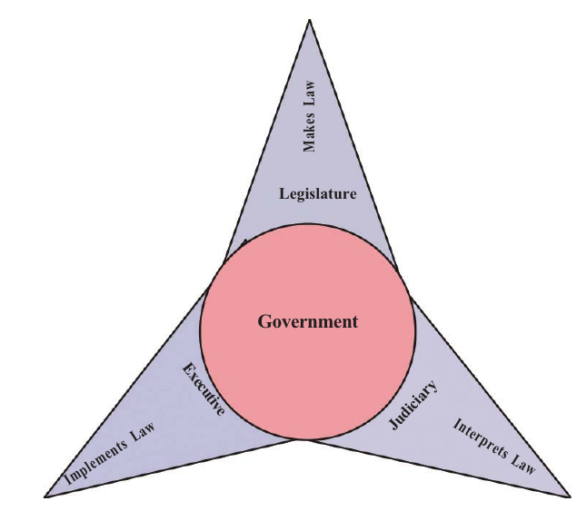
THE ORGANS OF THE GOVERNMENT

Slide 7

WRITE A SHORT NOTE ON THE ORGANS BASED ON THE GIVEN PICTURE

